Slide 1
ADVANCED OBJECT ORIENTED PROGRAMMING Credit Card Management System
By
2110030107 Manjunadha
2110030137 Junaid
2110030142 Pawan
2110030143 Rohith Sai
Under the guidance of
Ms. Figlu Mohanty

Slide 2
Problem statement
Creating a Java application that helps in storing user credit card details.
**With a secure and well developed data server **
As many of them don’t remember the details of their each credit card they have or some people my keep their credit cards somewhere and they get lost or hard to find in home.
And many websites have data breaches that leaks all the users data including their credit/Debit Card details.

Slide 3
Solutions
We I’ll create a secure web application that helps the user to save their credit card details.
Every user can use their details easily by just logging in to their account.
We also provide which websites have your data as well as the previous data breaches you had.
We developed an algorithm that checks whether the entered details are right !!

Slide 4
Card Design Technique
Take a Credit Card number.
Ignore the last digit
Take alternate numbers in a credit card and multiply with ‘2’
Add the answers after multiplying and add the remaining digits left after taking alternate numbers.
Add the both solutions [Alternate (multiplied by 2) + Remaining digits]
Divide the answer with 10.
The tenth place of the remainder is the ignored digit of the number.
If not that’s not a valid Credit/Debit card.

Slide 5
Identification By Card Number
First Digit identification is as follows :-
1 and 2 are Airlines
3 is Travel and Entertainment
4 and 5 Banking and Financial
6 is Merchandising and Banking
7 is Petroleum
8 is Telecommunication
9 is National Officials

Slide 6
Identify Issuer by Identification Number
Visa - 4XXXXXXX
Master Card – 51XXXXX {or} 55XXXX
Discover – 6011XXX {or} 644XXXX
American Express – 34XXXX {or} 37XXXX

Slide 7
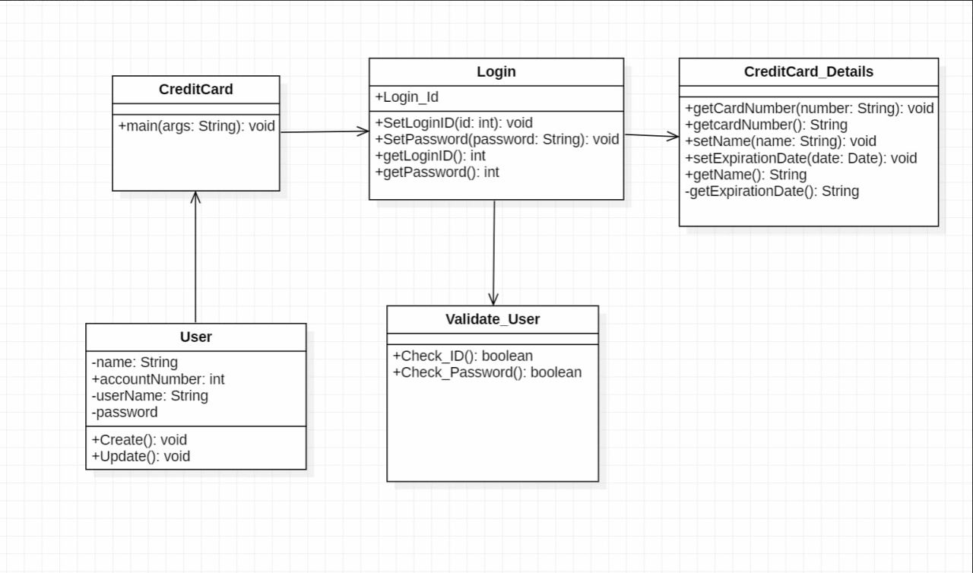
Class Diagram

Slide 8
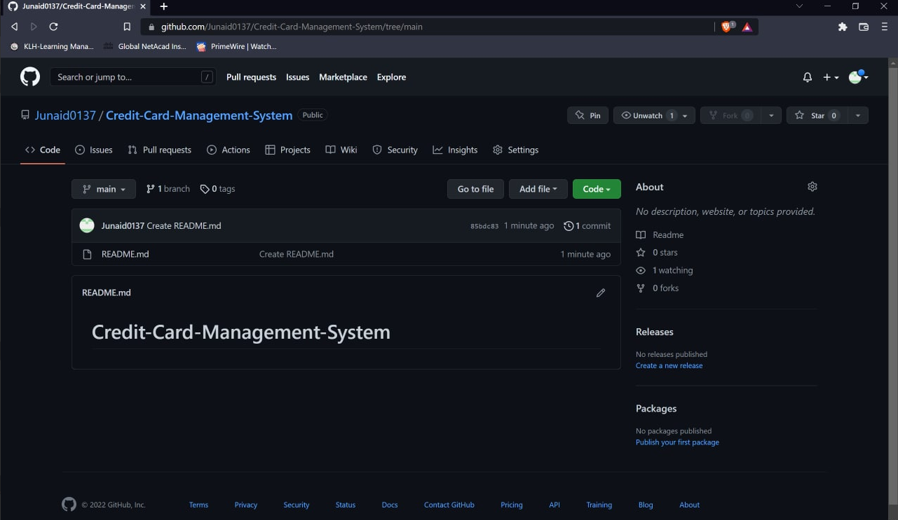

GitHub Setup -
https://github.com/Junaid0137/Credit-Card-Management-System/tree/main

Slide 9


